Slide 1
Weekly Skills Practice
Grade: 3rd Math Week of May 4, 2020

Slide 2
Monday, May 4th
Which division equation can be solved using 3 x ___ = 27
A. 27 ÷ 3 =
B. 3 ÷ 27 =
C. __ ÷ 27 = 3
D. __ ÷ 3 = 27
Octavian’s apple weighs 93 grams. His pear weighs 152 grams. What is the total weight of the apple and the pear?
3. Lunch starts at 11:07 and ends at 11:55. How long do you have to eat your lunch?

Slide 3
Tuesday, May 5th
Katerika bakes 14 bagels. She puts all of the bagels into 7 bags. Each bag has the same number of bagels. How many bagels does Katerika put into each bag? Write a division equation and a multiplication equation that you can use to solve the problem.
Ms. Boyd bought 4 bags of skittles. Each bag weighs 7 kilograms. How many kilograms does of skittles does Ms. Boyd have?
3. There are 18 fish. Each bowl holds 6 fish. What number sentence shows the number of bowls?

Slide 4
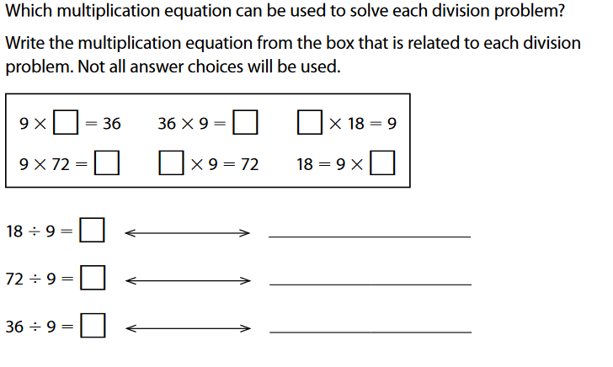
Wednesday, May 6th

Slide 5
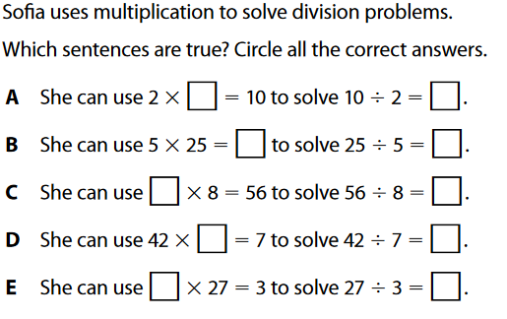
Thursday, MAy 7th

Slide 6
Friday, May 8th
Lenny has 48 crackers divided into piles. There are 8 crackers in each pile. How many piles of crackers does Lenny have? Write a division equation and a multiplication equation that you can use to solve the problem.
Which problem cannot be solved using multiplication?
A model train has 8 cars. Each car is 6 inches long. How long is the model train?
Max had 5 shells. He found 7 more shells. How many shells does Max have in all?
C. There are 3 birds in each of 4 trees. How many birds are in all of the trees?
3. Select the numbers that round to 50:
45 39 53 56 47 56

Slide 7
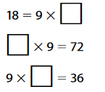
Answers
Monday | Tuesday | Wednesday | Thursday | Friday
1. A | 14 ÷ 7 = 7 x __ = 14 |  | A, C | 48 ÷ 8 = 8 x __= 48
2. 245 g | 2. 28 kg |  |  | 2. B
3. 48 minutes | 3. 18 ÷ 6 = |  |  | 3. 45, 53, 47

